Slide 1
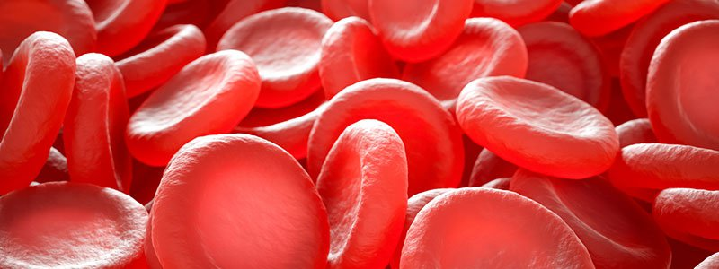
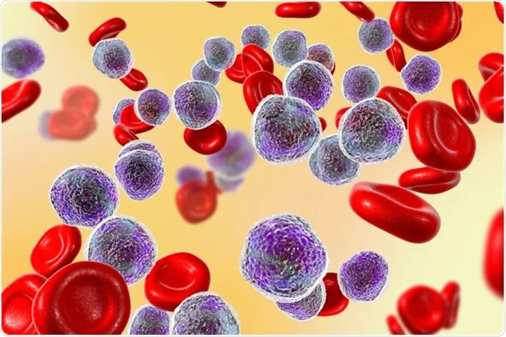
Nursing Management for Patients with Blood Disorders
By
A. L. Maher Abdul Ameer

Slide 2
Outline
Blood and its components.
Diagnostic tests for blood disease.
Anemia.
Leukemia

Slide 3
Blood
Blood is a fluid that moves through the vessels of a circulatory system. it includes :
Plasma is the main component of blood and consists mostly of water, with proteins, ions, nutrients, and wastes mixed in.
Red blood cells are responsible for carrying oxygen and carbon dioxide.
Platelets are responsible for blood clotting.
White blood cells are part of the immune system and function in immune response.

Slide 4
Blood and its contents
Blood is unique it’s the only fluid tissue that appears to be thick, homogenous liquid.
Volume: 5 to 6 liters.
Color: Varies from scarlet (Oxygen-rich) to a dull red (oxygen-poor).
It is heavier than water and five times thicker.
PH: is slightly alkaline: 7.35-7.45.
Blood accounts for about 8% of body weight.
During centrifuge, heavy elements are packed down and the plasma rises to the top.

Slide 6
Diagnostic tests for blood disease
Types of Blood Tests
Some of the most common blood tests are:
A complete blood count (CBC)
Blood chemistry tests
Blood enzyme tests
Blood tests to assess heart disease risk
Blood clotting tests

Slide 7
Production of Formed Elements
Hematopoiesis or hemopoiesis: Process of blood cell production
Stem cells: All formed elements derived from single population
Proerythroblasts: Develop into red blood cells
Myeloblasts: Develop into basophils, neutrophils, eosinophils
Lymphoblasts: Develop into lymphocytes
Monoblasts: Develop into monocytes
Megakaryoblasts: Develop into platelets

Slide 9
Anemia
Anemia is a term that refers to a deficiency of either erythrocytes or hemoglobin.
Other definition: a condition in which there is reduced delivery of oxygen to the tissues as a result of reduced numbers of red cells or hemoglobin.
Hemoglobin is a main part of red blood cells and binds oxygen.

Slide 10
Causes of Anemia
1. Anemia Caused by Blood Loss
Red blood cells can be lost through bleeding, which can occur slowly over a long period of time, and can often go undetected.
This kind of chronic bleeding commonly results from the following:
A. Gastrointestinal conditions such as ulcers, hemorrhoids, gastritis and cancer.

Slide 11
B. Use of non-steroidal anti-inflammatory drugs (NSAIDS)
such as aspirin or ibuprofen, which can cause ulcers and gastritis.
C. Menstruation and childbirth in women, especially if menstrual bleeding is excessive.

Slide 12
Causes of Anemia
2. Anemia Caused by Decreased or Faulty Red Blood Cell Production
This type of anemia, the body may produce too few blood cells or the blood cells may not function correctly.

Slide 13
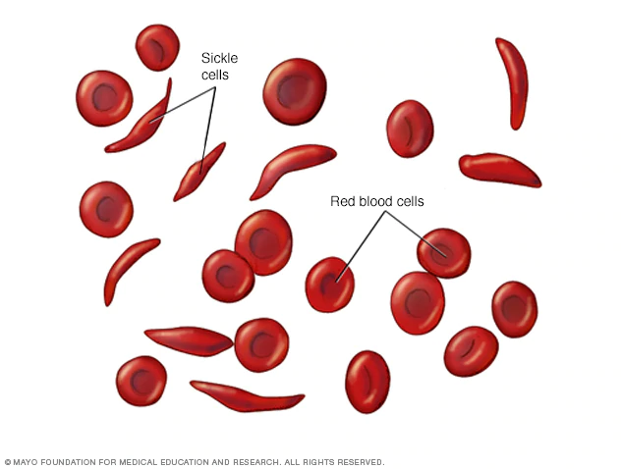
Conditions associated with these causes of anemia include the following:
Sickle cell anemia.
Iron-deficiency anemia.
Vitamin deficiency.
Bone marrow and stem cell problems.
Other health conditions

Slide 14
3. Anemia Caused by Destruction of Red Blood Cells
When red blood cells are fragile and cannot withstand the routine stress of the circulatory system, they may rupture prematurely, causing hemolytic anemia. Hemolytic anemia can be present at birth or develop later. Sometimes there is no known cause.

Slide 15
Types of anemia
1. Iron-deficiency anemia: occurs because of a lack of the mineral iron in the body. Bone marrow in the center of the bone needs iron to make hemoglobin, the part of the red blood cell that transports oxygen to the body's organs. Without adequate iron, the body cannot produce enough hemoglobin for red blood cells.
The result is iron-deficiency anemia.

Slide 16
Pernicious Anemia
2. Pernicious Anemia: The intrinsic factor is missing in pernicious anemia, resulting in an inability to absorb vitamin B12. Pernicious anemia is common in the elderly and clients who have had a gastric resection.
It can also occur from poor dietary intake of foods containing B12, especially in vegetarian diets or those lacking dairy products.

Slide 17
Aplastic anemia
3. Aplastic anemia is a rare disease caused by a decrease in or damage to marrow stem cells, damage to the microenvironment within the marrow, and replacement of the marrow with fat.

Slide 18
Thalassemia
4. Thalassemia are a group of hereditary disorders associated with defective hemoglobin-chain synthesis..
Thalassemias are characterized by hypochromia (an abnormal decrease in the hemoglobin content of RBCs), extreme microcytosis (smaller-than-normal RBCs), destruction of blood elements (hemolysis), and variable degrees of anemia.

Slide 19
Nursing Diagnoses
Fatigue related to decreased hemoglobin and diminished oxygen-carrying capacity of the blood.
Altered nutrition, less than body requirements, related to inadequate intake of essential nutrients.
Altered tissue perfusion related to inadequate blood volume or hematocrit.
Noncompliance with prescribed therapy.

Slide 20
Nursing Interventions
A: Managing Fatigue
1. Assisting the patient to prioritize activities and to establish a balance between activities and rest that is realistic and feasible from the patient's perspective.
2. Patients with chronic anemia need to maintain some physical activity and exercise to prevent the deconditioning that results from inactivity.

Slide 21
Nursing Interventions
B: Maintaining Adequate Nutrition
1. A healthy diet rich in iron, vitamin B12, folic acid, and protein should be encouraged.
2. Advise the patient to avoid alcoholic beverages.

Slide 22
Nursing Interventions
C: Maintaining Adequate Perfusion
1. Lost volume is replaced with transfusions or intravenous (IV) fluids.
2. Supplemental oxygen may be necessary, but it is rarely needed on a long-term basis unless there is underlying severe cardiac or pulmonary disease.
3. The nurse monitors the patient's vital signs and pulse oximeter readings closely.

Slide 23
Nursing Interventions
D: Monitoring and Managing Potential Complications
1. Patient with anemia should be assessed for signs and symptoms of heart failure. A daily record of body weight can be more useful and accurate than a record of intake and output.
2. Diuretics may be required if fluid retention results from heart failure.

Slide 24
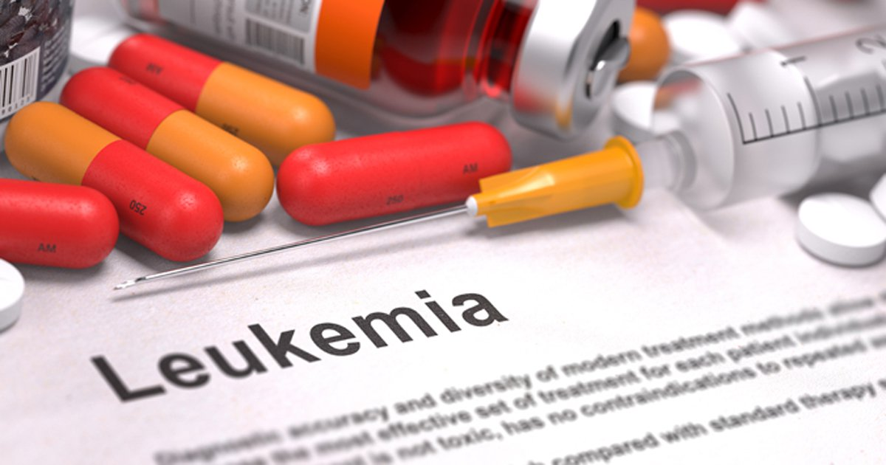

Slide 25
Leukemia
Leukemia, also spelled leukaemia, is a group of blood cancers that usually begin in the bone marrow and result in high numbers of abnormal blood cells. These blood cells are not fully developed and are called blasts or leukemia cells.
Leukemia: is a disease characterized by abnormal and excessive production of white blood cells, many in immature form.
The white blood cells are produced either in the bone marrow or by the lymphoid tissues of the body (spleen and lymph nodes)

Slide 26
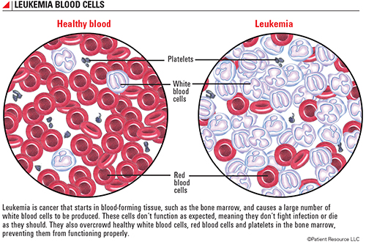

Slide 27
Classifications of leukemia
The first type of classification is by how fast the leukemia progresses:
Acute leukemia: In acute leukemia, the abnormal blood cells are immature blood cells (blasts).
Chronic leukemia: There are many types of chronic leukemia. Some produce too many cells and some cause too few cells to be produced. Chronic leukemia involves more mature blood cells.

Slide 28
The second type of classification is by type of white blood cell affected:
Lymphocytic leukemia: This type of leukemia affects the lymphoid cells (lymphocytes), which form lymphoid or lymphatic tissue. Lymphatic tissue makes up immune system.
Myelogenous leukemia: This type of leukemia affects the myeloid cells. Myeloid cells give rise to red blood cells, white blood cells and platelet-producing cells.

Slide 29
Types of Leukemia
Acute lymphocytic leukemia (ALL): This is the most common type of leukemia in young children. ALL can also occur in adults.
Acute myelogenous leukemia (AML): AML is a common type of leukemia. It occurs in children and adults. AML is the most common type of acute leukemia in adults.
Chronic lymphocytic leukemia (CLL): With CLL, the most common chronic adult leukemia, may feel well for years without needing treatment.
Chronic myelogenous leukemia (CML): This type of leukemia mainly affects adults. A person with CML may have few or no symptoms for months or years before entering a phase in which the leukemia cells grow more quickly.

Slide 30
Causes of leukemia:
The main cause is unknown.
Genetic factors.
Viral pathogenesis.
Bone marrow damage.
Exposure to large amounts of radiation.
Exposure to some certain chemicals at work, such as benzene.
Chemotherapy to treat another cancer.

Slide 31
Clinical manifestation (S&S):
Leukemia symptoms depending on the type of leukemia.
Common leukemia signs and symptoms include:
Fever or chills
Persistent fatigue, weakness
Frequent or severe infections
Losing weight without trying
Swollen lymph nodes, enlarged liver or spleen
Easy bleeding or bruising
Recurrent nosebleeds
Tiny red spots in the skin (petechiae)
Excessive sweating, especially at night
Bone pain or tenderness

Slide 32
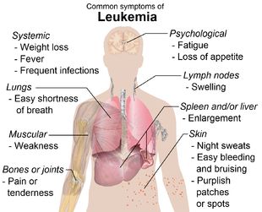

Slide 33
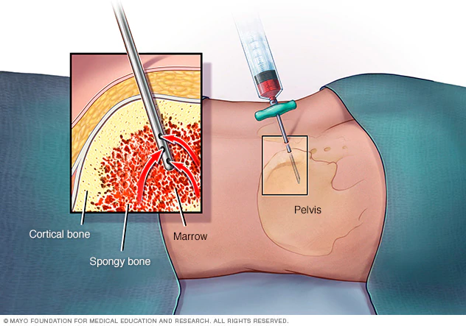
Diagnosis
Physical exam: look for physical signs of leukemia, such as pale skin from anemia, swelling of lymph nodes, and enlargement of liver and spleen.
Blood tests: By looking at a sample of blood, can determine if have abnormal levels of red or white blood cells or platelets.
Bone marrow test: recommend a procedure to remove a sample of bone marrow from hipbone. The bone marrow is removed using a long, thin needle.

Slide 34
Treatment
Chemotherapy: is the major form of treatment for leukemia. This drug treatment uses chemicals to kill leukemia cells.
Depending on the type of leukemia, may receive a single drug or a combination of drugs. These drugs may come in a pill form, or they may be injected directly into a vein

Slide 35
Biological therapy: Biological therapy works by using treatments that help immune system recognize and attack leukemia cells.
Radiation therapy: Radiation therapy uses high-dose X-rays to destroy cancer cells and shrink swollen lymph nodes or an enlarged spleen.
Stem cell transplant: A stem cell transplant is a procedure to replace diseased bone marrow with healthy bone marrow.
Before a stem cell transplant, receive high doses of chemotherapy or radiation therapy to destroy disease bone marrow. Then receive an infusion of blood-forming stem cells that help to rebuild bone marrow.

Slide 36
Nursing Diagnosis:
Risk for infection related to decreased WBCs, chemotherapy and radiation.
Risk for impaired skin integrity related to toxic effects of chemotherapy, alteration in nutrition, and impaired mobility.
High risk for injury or hemorrhage related to disease process, trauma. And chemotherapy.
Anxiety related to change in health status and threat of death.
Deficient knowledge about disease process, treatment, complication management, and self-care measures.

Slide 37
Nursing Interventions:
1.Preventing or Managing Infection and Bleeding.
2. Improving Nutritional Intake.
3. Easing Pain and Discomfort.
4. Decreasing Fatigue and Deconditioning.
5. Maintaining Fluid and Electrolyte Balance.
6. Improving Self-Care.
7. Managing Anxiety and Grief.

